Slide 1
Girls Who Code
YOU RULE!!!!!!
Now check out some fun 411 from a fellow coder friend-Anita Russo

Slide 2
Introduction
I’m at the University of Georgia because I knocked on the door and persisted with my talent (I showed my maps for which I automated many data aggregation processes with scripts to make and was able to apply those to more than one map in one location).
I continued coding because it just made things easier to do.
I failed a lot, but I persisted until something worked. There was no Google.
My first application where there was user input and installation needed was an automated letter cgi script (No, this was not computer generated imagery that is very $$$, this stood for common gateway interface)

Slide 3

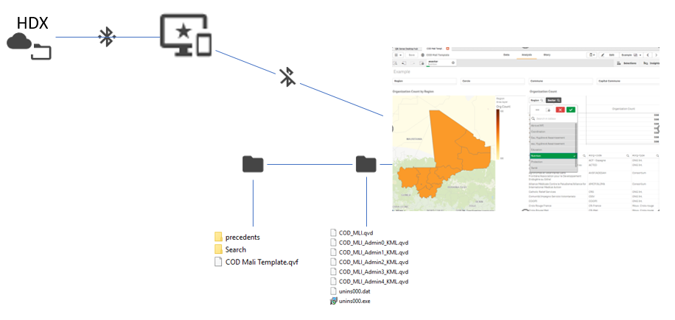

Then and Now
Local Machines
Distributed Local Networks
Broad Network and Internet
Security
Services
Software as a Service (SAAS)

Slide 4
And Now…
Code builds many layers and is built on frameworks
What the user sees and interacts with- view
The description of information and patterns stitching them together- model
The persisting standardized and stored information- data

Slide 5
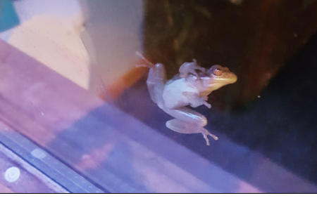
Web application Example
This “web” of frameworks, libraries and tiers can help save lives, manage money, and protect the environment
GNAHRGIS Ecology helps protect environmental instances
Instances are registered on the map and can be analyzed and reported
Let’s dive in!

Slide 6
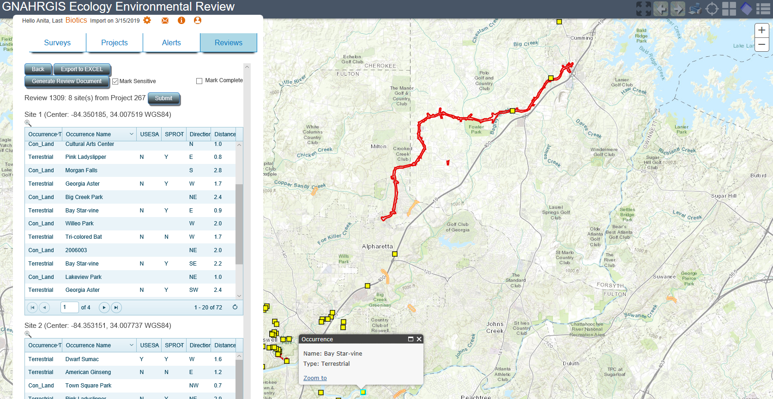

Slide 7
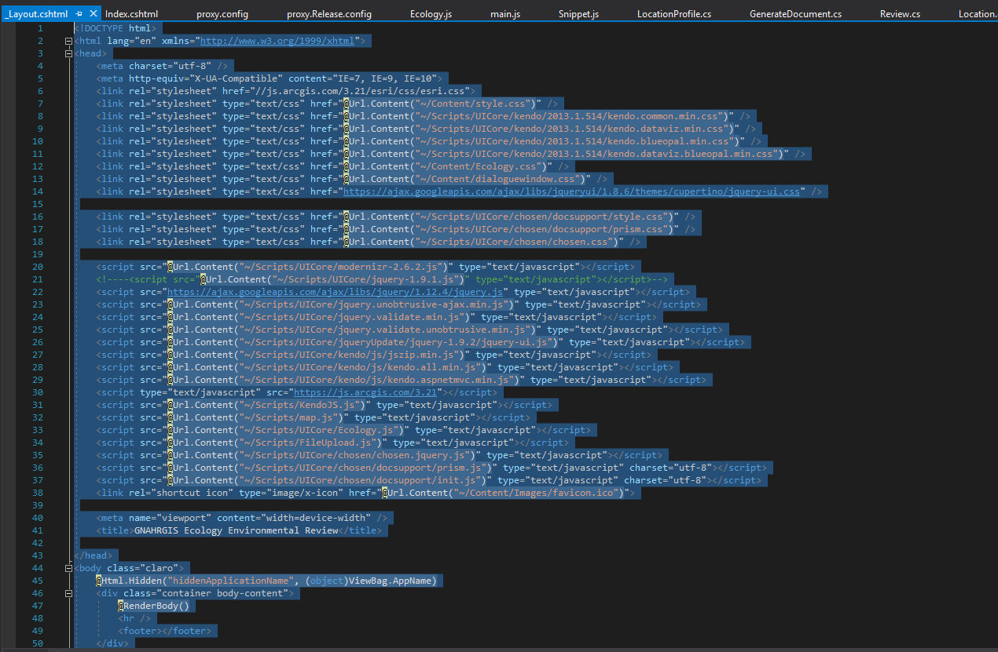
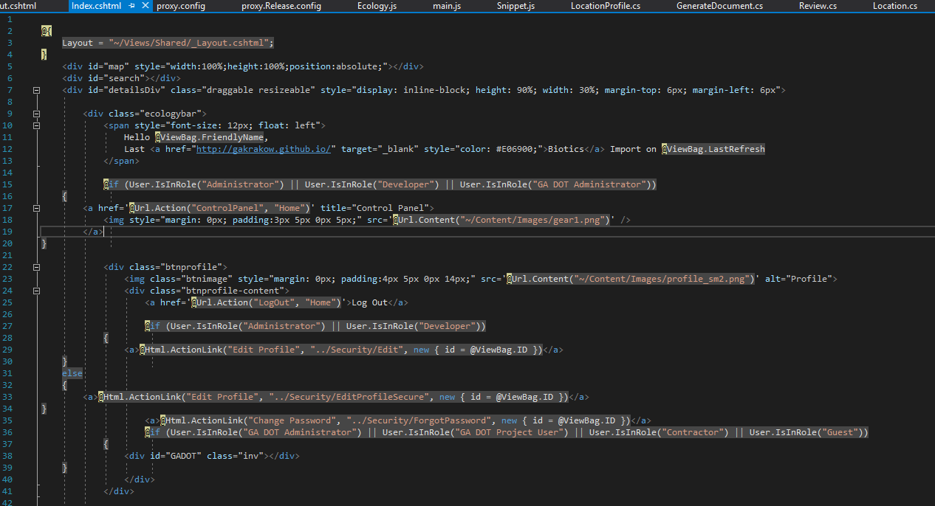
Web application –The View

Slide 8
Web application –The Model
The view relies on the model to create a footprint or floorplan where the constantly changing, map, pictures, text, video and other content in the view can be assembled. The view is like the floorplan so that the bedroom furniture doesn’t wind up in the kitchen. The model is the bedroom furniture definitions and specifications
Made up of classes, usually one file of code per class

Slide 9
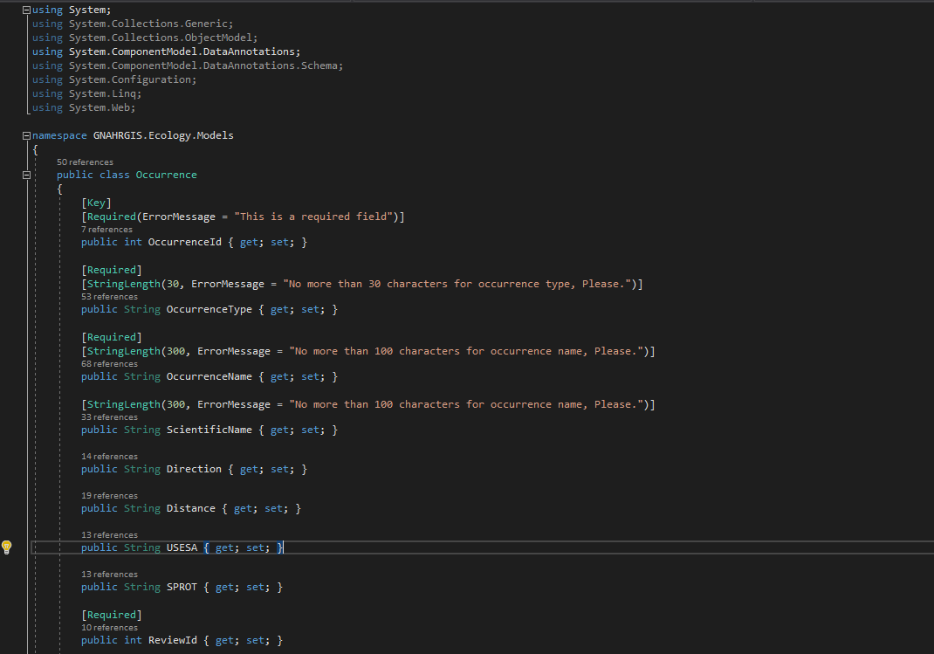
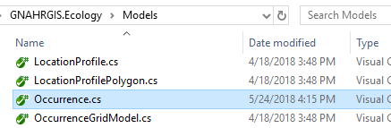
Web application –The Model
The view relies on the model to create a footprint or floorplan where the constantly changing, map, pictures, text, video and other content in the view can be assembled. The model is like the floorplan so that the bedroom furniture doesn’t wind up in the kitchen
Made up of classes, usually one file of code per class

Slide 10
Web application –The Data
The data is the information that can be fetched and acted upon in the application in a container, such as a database or series of files
In GNAHRGIS Ecology, it is the species, the location coordinates, the project areas etc.
The species data not captured for a project in time are in a Biotics database. It is highly secure, and does not tolerate any bad actors

Slide 11
Putting it All together
A series of client javascript interpreted by the browser makes requests to controllers in the application
The controllers understand the kind of information sent in a request, and are uniquely configured to pass the information back in a certain format the view understands

Slide 12
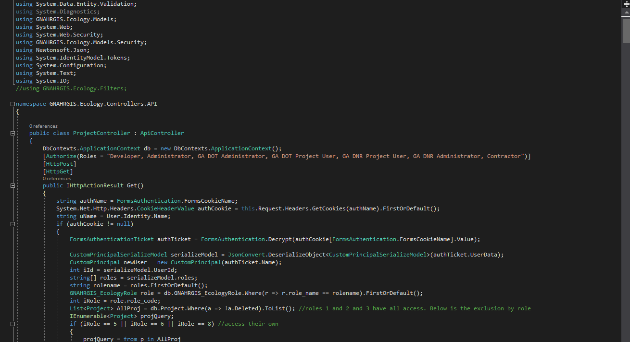
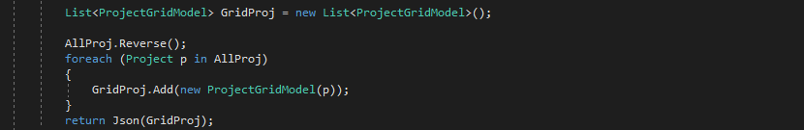
Putting it All together
The controller has actions (GET, POST) and may run logic as well before sending the results back

Slide 13
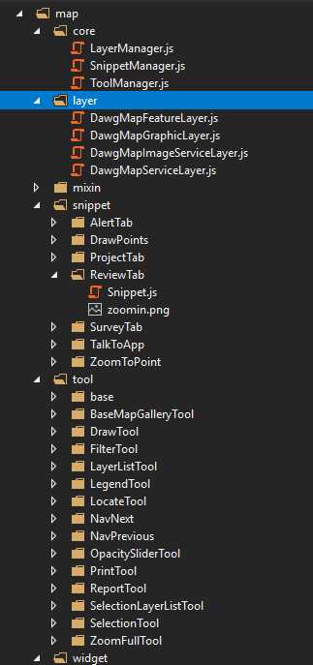
Putting it All together
The user interacts with the browser in this example, the code that interprets that is javascript

Slide 14
Putting it All together
Many buttons, widgets and workflows on the page are possible in this example, so there are lots of files to manage this user input to get the information back to the web server
Because the browser has many tabs and states, it doesn’t know what to do in what order even when the user clicks in a series of steps. The information is sent back to the server in any order (AJAX) so there are mechanisms to ensure the proper information is being handled. Deferreds and callbacks
Example/demo

Slide 15
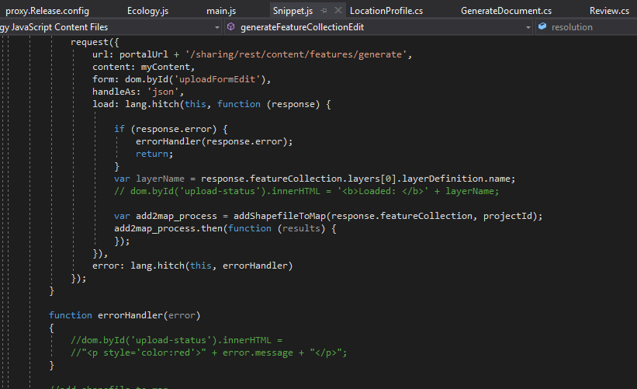
Putting it All together
Example:

Slide 16
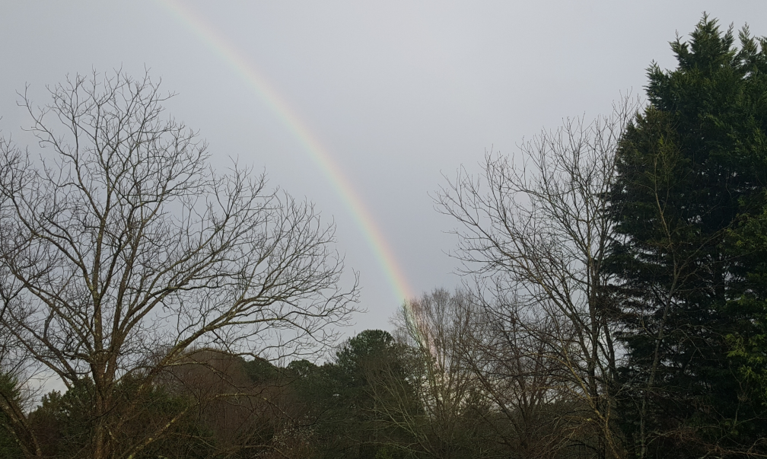
Here we sum it all up
Coding is fun!
Building something useful is rewarding
There are many options
Persist, persist, persist!!!!!

